Slide 1
Coding Center of Excellence Design Pattern: Mediator

Slide 2

Mediator Design Pattern Overview
Also known as: Intermediary, Controller.
This design pattern is useful when there are several objects trying to communicate with each other during the execution of a program. To prevent communication chaos and restrict interactions between the objects, they must communicate through a Mediator object.

Slide 3
Type: Behavioral
Motivation
Applicability
Structure
Participants
Collaborations
Consequences
Implementation
Code Samples
Mediator
Agenda

Slide 4
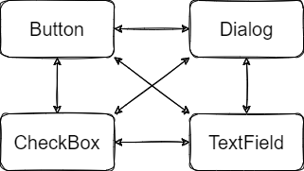
Type: Behavioral
Mediator
Motivation

Slide 5
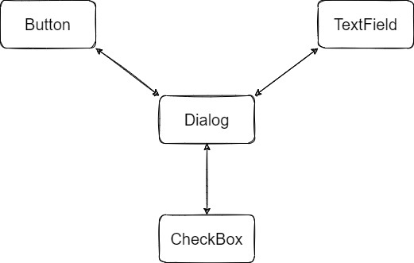
Type: Behavioral
Mediator
Applicability
Notes:
Mediator suggests: - cease all direct communication between the components - these components must collaborate indirectly, by calling a special mediator object - the components end up depending only on a single mediator

Slide 6
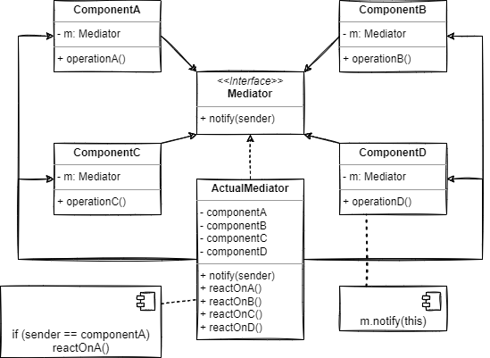
Type: Behavioral
Mediator
Structure
Notes:
Components: Classes with some business logic. Each component references the mediator (via interface). Each component can be reused since they don’t know the type of the mediator class, they only assume the mediator implements the interface. Components notify the mediator about their actions and can even pass arguments, if they don’t cause any coupling between the receiver component and the sender’s class.
Mediator: Contains methods to communicate with the components. Can manager its own lifecycle and contains references to all its related components to encapsulate their relation.
Components don’t know about other components. They only have to notify the mediator about their actions and the mediator will identify the caller and if necessary, trigger actions on the other components.

Slide 7
Type: Behavioral
- Mediator interface: Declares the notify() method and can be implemented by other classes that will serve as actual mediators.
- Implemented Mediator: Receives notifications from the components, identifies the calling component and triggers actions on other components when needed.
- Component(s): Element that notifies the Mediator about its behavior and exposes behavior to be invoked.
Mediator
Participants

Slide 8
Type: Behavioral
Mediator
Several components can collaborate with each other to in an ordered fashion by notifying a Mediator about their tasks.
Collaborations

Slide 9
Type: Behavioral
✔ Single Responsibility Principle
✔ Open/Close Principle
✔ No Coupling ✔ Code reusability
❌ If a mediator is not kept simple, it can become God Object.
Mediator
Consequences
Notes:
Consider using a mediator when it’s hard to change classes because they’re tightly coupled to other classes. The mediator will extract the relationships between the classes and isolate the changes to itself so that the can collaborate with other components. - Use the mediator when you need to reuse a component but it can’t be used on a different program because it’s tightly coupled to other components.
Use the mediator when you find yourself building too much component sub-classes just to be able to reuse basic behavior on other contexts.

Slide 10
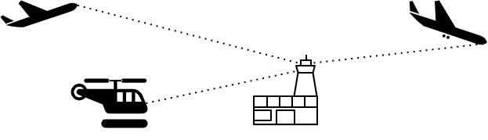
Type: Behavioral
Mediator
Implementation
Notes:
- Identify a group of tightly coupled classes which would benefit from being more independent. - Declare the mediator interface. - Implement a mediator class. - Components should store a reference to the mediator class.

Slide 11

Type: Behavioral
Mediator
Code Samples

Slide 12
Refactoring.Guru. (n.d.). Mediator. Retrieved January 25, 2022, from https://refactoring.guru/design-patterns/mediator
Diagrams: https://app.diagrams.net/
Github logo
References and
Resources

